Slide 1
Alarms and Notifications
Module 8

Slide 2
Module Objectives
Upon completion of this module, you will be able to:
Create an alarm from a McAfee SIEM event within ESMI.
Configure alarm conditions to meet specific monitoring objectives.
Respond to triggered alarms using the built-in ESMI view “triggered alarms”.

Slide 3

Module Topics
Alarms
Creating Alarms
Alarm Settings, Conditions and Actions
Alarm Logs
Triggered Alarms View

Slide 4

Alarms
The Alarm feature allows you to set up the system to provide real-time alarms when a condition that you define occurs.
When an alarm is triggered, it automatically is added to the Alarms log, located in the pane under the System Navigation Tree pane, as well as the Triggered Alarms View.
You can configure an Alarm action to:
Log an event to the ESM
Provide a visual and auditory alert
Create a case for a specific person or group
Execute a script
Update a Watchlist
Send an event to remedy
Send a text or email

Slide 5

Alarms
Alarms are GREAT for taking some sort of action when a HIGH Priority Event Occurs

Slide 6
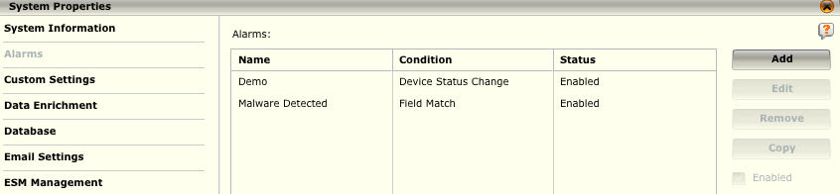
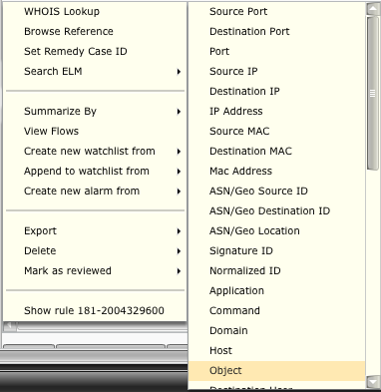

Create Alarm
Alarms can be created by
Selecting the desired event from any view
Through the ESM Alarm properties screen
Selecting a rule from Policy Manger and adding an alarm
Notes:
Alarms can be created either by selecting the desired event from any view, by adding a new alarm through the ESM Alarm properties screen or by selecting a rule within policy manager and adding the alarm.

Slide 7
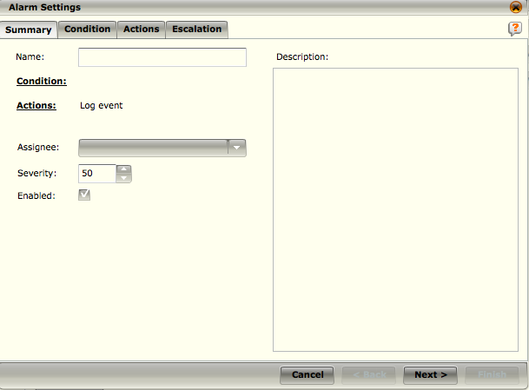
Alarm Settings
The ability to add an alarm is available to users with administrator privileges and any user belonging to an access group with the Alarm Management privilege.
The Alarm Settings screen has 4 tabs:
Summary
Condition
Actions
Escalation
Notes:
The Alarm Settings screen has 4 tabs, a summary, condition, actions and escalation.
Summary – An overall summary of the alarm properties, including the name and severity.
Condition – The condition which will trigger the alarm. Conditions include Field Match, Device Status Change, Deviation from Baseline, Device Failure, Device Status Change, and Specified Event Rate.
Action – The desired action to be taken, including the ability to pass data as parameters into a script to be executed.
Escalation – If an assignee leaves an alarm unacknowledged after the specified period of time, escalation defines a secondary set of actions to be taken.

Slide 8
Alarm Settings - Summary
Name – The name of the alarm, this will show in email and other notifications.
Condition – A hyperlink to the conditions tab.
Actions – A hyperlink to the actions tab.
Assignee – The person to whom the alarm is assigned.
Severity – The alarm severity, 0 – 100.
Enabled – If unchecked the alarm actions will not trigger in response to a match.

Slide 9
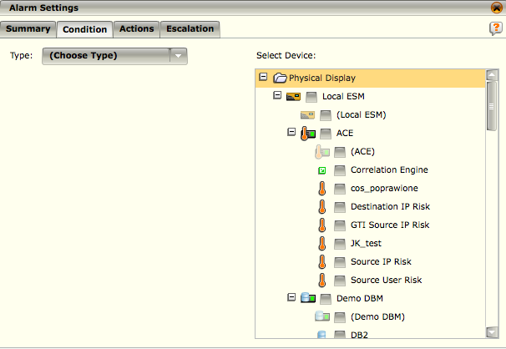
Alarm Setting - Conditions
The condition is considered the trigger for the alarm based on the type selected.
Type – Select the condition type. Each type will have its own parameters.
Deviation from baseline
Device Failure
Device Status Change
FIPS Failure
Field Match
HA Failure
Specified Event Rate

Slide 10
Alarm Settings – Condition Types
Each type has its own unique set of conditions that need to be configured.
Condition | Alarm Type | Details
Check Rate | Device Failure, FIPS Failure, Deviation from Baseline, HA Failure | Select how often the system should check to see if this type of condition exists.
Deviation | Deviation from Baseline | This condition allows you to specify a percentage threshold to check above baseline and/or a different percentage below baseline.
Event Rate | Specified Event Rate | The number of events that need to occur before an alarm is generated. You will also set a time period in which the events need to occur.
Field Match | Field Match | The type of field and the value that must be matched. Field match can also match watchlist values.
Maximum Condition Trigger Frequency | All alarms except for Deviation from Baseline | Since events can be experienced on a sustained basis, select the amount of time to allow between each condition is defined to prevent a flood of notifications from being sent.
Health Monitor Status | Device Status Change | Select the types of device status changes about which you want to be notified.

Slide 11
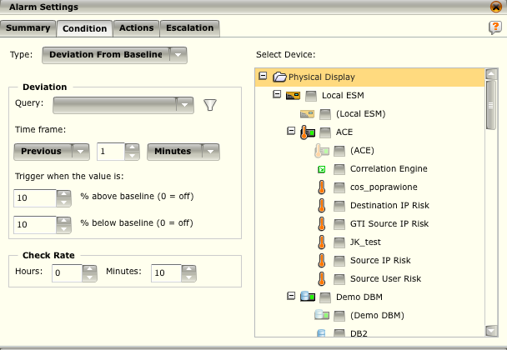
Alarm Setting - Conditions
For the condition type Deviation from baseline we need to configure:
The Query
Time Frame
% above baseline
% below baseline
Check Rate
Select the devices to monitor for the alarm condition

Slide 12
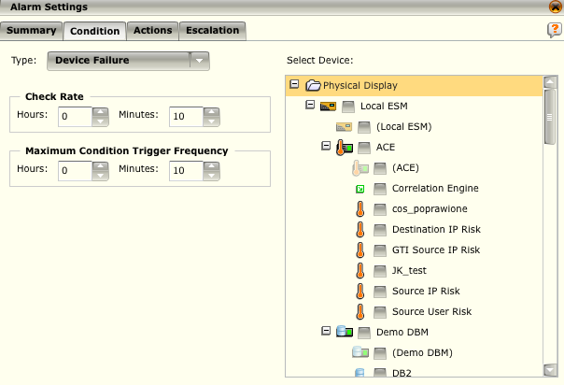
Alarm Setting - Conditions
For the condition type Device Failure we need to configure:
Check Rate
Maximum Condition Trigger Frequency
Select the devices to monitor for the alarm condition

Slide 13
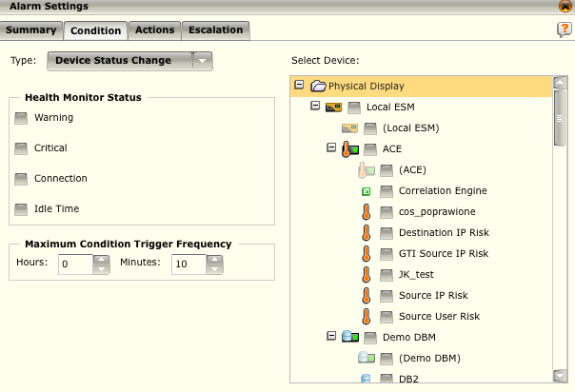
Alarm Setting - Conditions
For the condition type Device Status Change we need to configure:
Health Monitor Status
Maximum Condition Trigger Frequency
Select the devices to monitor for the alarm condition

Slide 14

Alarm Setting - Conditions
For the condition type FIPS Failure we need to configure:
Check Rate
Maximum Condition Trigger Frequency
Select the devices to monitor for the alarm condition

Slide 15
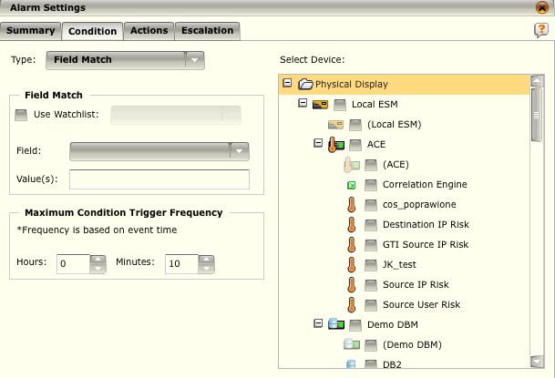
Alarm Setting - Conditions
For the condition type Field Match we need to configure:
Field Match
Maximum Condition Trigger Frequency
Select the devices to monitor for the alarm condition

Slide 16
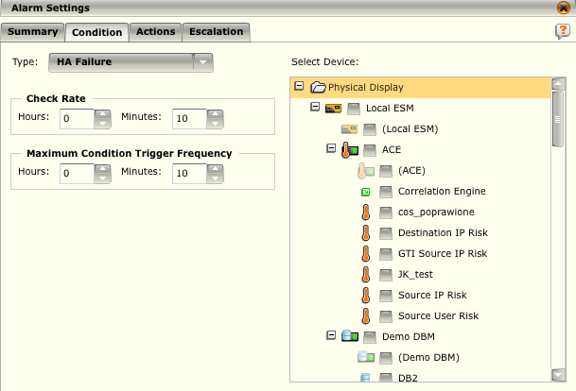
Alarm Setting - Conditions
For the condition type HA Failure we need to configure:
Check Rate
Maximum Condition Trigger Frequency
Select the devices to monitor for the alarm condition

Slide 17
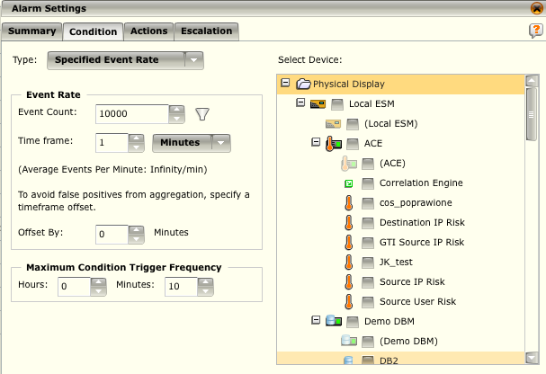
Alarm Setting - Conditions
For the condition type Field Match we need to configure:
Event Rate
Maximum Condition Trigger Frequency
Select the devices to monitor for the alarm condition
NOTE
Due to event aggregation false positives can result if the correct offset is not configured.
Notes:
Since the rate data for an event will include a sharp increase at the end created by aggregation, select the amount of time by which you want the time frame offset in the Offset By field so that it won't include that sharp increase. For example, if your ESM pulls events every 5 minutes, the last 1 minute of the events retrieved will contain the aggregated events. You would, therefore, want to offset the time frame by that period of time so the last 1 minute would not be included in the data measurement. If you don't do this, the values in the aggregated data will be included in the event count, very likely causing a false positive.

Slide 18
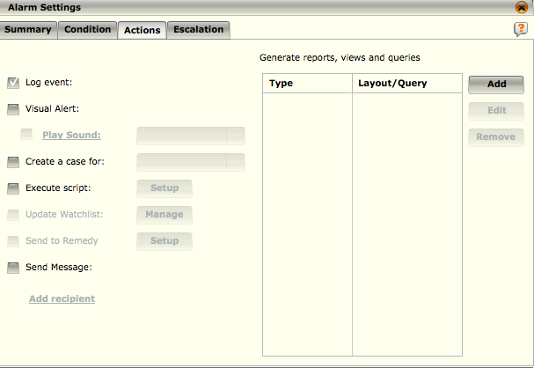
Alarm Settings - Action
Log event – Logs an event to the alarm log for review and tracking.
Visual Alert – Triggers a visual alert on the bottom right of the screen.
You can also choose an audio alert that will play.
Create a Case for – Creates a case which is assigned to a selected user.
Execute script – executes a script on a bastion host. You may pass parameters from the triggering event into the script.
Send Message – Sends an email or SMS message to the recipients.
Escalation – If the alarm is not acknowledged or cleared within the specified timeframe, a second set of actions can be taken to ensure it doesn’t go unnoticed.

Slide 19
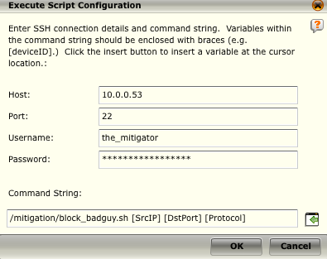
Alarm Settings – Action Execute Script
The Execute Script action provides limitless automated mitigation capabilities by allowing event parameters to be passed to custom scripts on a remote server for execution
NOTE
Executing scripts can be used in all alarm types, but only the Field Match alarm type tracks specific events and will have variables to insert into the command string.

Slide 20
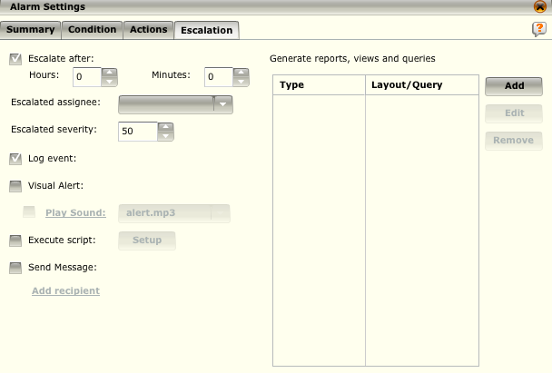
Alarm Settings - Action
If you want to escalate the alarm click on the Escalate after check box
Select the number of hours and/or minutes after which the alarm should be escalated if it isn't acknowledged
In the Escalated assignee field, select the person or group who should receive notification
Select the severity that this alarm should have when it has been escalated
Select the action that should be taken when the alarm has been escalated
NOTE
You can't use the Update Watchlist, Send to Remedy, or Create a Case actions in the Escalation tab.

Slide 21
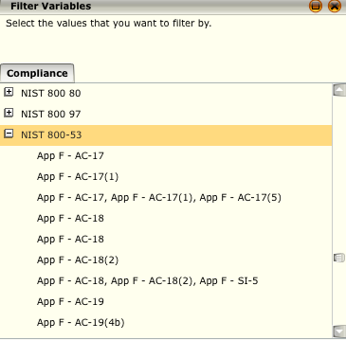
Alarm Settings Additional Notes
Once an alarm has been added, it will begin to trigger when the conditions are met.
For example, if the Maximum Condition Trigger Frequency is set to 15 minutes, the alarm will trigger for the first time when the number of events specified in the Event Count field occur within a 15-minute period. Events that come in during the first 15 minutes will not trigger the alarm.
UCF Filters
One of the challenges for regulation compliance support is the ever-changing nature of regulations.
Unified Compliance Framework (UCF) is an organization that maps the specifics of each regulation to harmonized control IDs.
As regulations change, these IDs are updated and pushed to the McAfee ESM.
The Compliance ID filter option allows you to select the required compliance or specific subcomponents and apply the filter so that only the appropriate events are displayed.

Slide 22
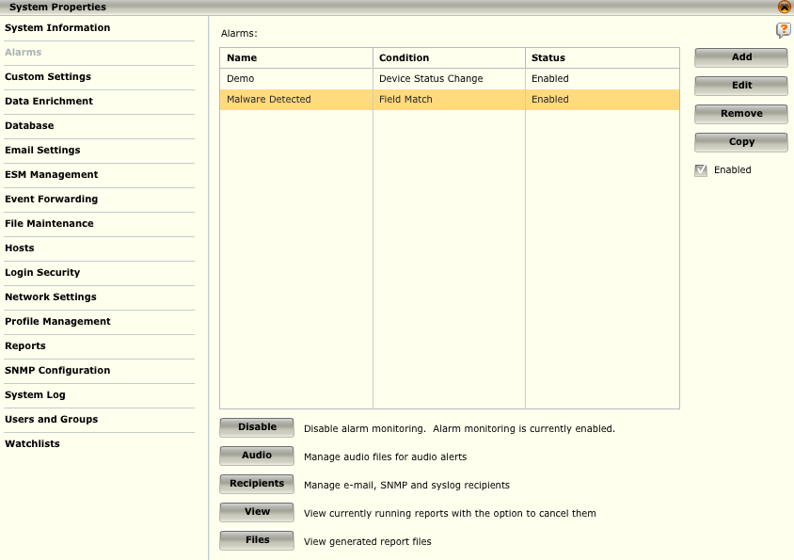
Additional Alarm Options
The Alarms dialog has five additional options:
Enable/Disable Alarm Monitoring
Manage Audio Files
Manage Recipients
View Reports Queue
Manage Report Files
Notes:
The Alarms dialog has five additional options:
Enable/Disable Alarm Monitoring - Allows you to enable and disable alarm monitoring.
Manage Audio Files - The Audio button opens the list of audio files on the system and allows you to download a file on the system to another location, upload an mp3 file from another location to the ESMI, remove a file from the list of available audio files, refresh the list after uploading a file, and play any of the audio files on the list.
Manage Recipients - The Recipient button gives you access to the Recipients dialog where you can add, edit, or remove recipients.
View Reports Queue - If you have alarm management rights, the View feature on this screen allows you to view the status, updated every 10 seconds, of all of the reports generated by alarms that you initiated and are currently in this queue.
Manage Report Files – This view provides a list of the reports that have been generated on the system.

Slide 23
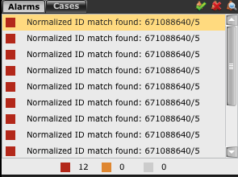
Alarms Log
When an alarm is triggered, the alarm notification will be added to the Alarms Log, which is located under the System Navigation Tree.
The bottom of the pane shows the total number of high ( ), medium ( ), and low ( ) severity alarms currently listed in the Alarms Log.
High is a severity of 66 to 100, medium is 33 to 65, and low is 1 to 32.
To acknowledge or delete a triggered alarm, click on it and then click on the Acknowledge icon ( ) or the Delete icon ( ).
When alarm is acknowledged, it will no longer appear on the Alarms log, but will still be listed on the Triggered Alarms view.
When you delete a triggered alarm, it will be removed from the Alarms log as well as from the Triggered Alarms view.
Notes:
Alarms Log:
You can acknowledge, delete, and view details of any of these triggered alarms. To acknowledge or delete a triggered alarm, click on it and then click on the Acknowledge icon or the Delete icon.
When you acknowledge a triggered alarm, it will no longer appear on the Alarms log, but will still be listed on the Triggered Alarms view. When you delete a triggered alarm, it will be removed from the Alarms log as well as from the Triggered Alarms view.

Slide 24
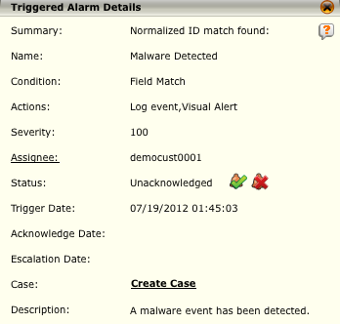
Alarm Details
To view the details of a triggered alarm click on the Details ( ) icon.
You can perform the following actions within the Triggered Alarm Details dialog:
Change the assignee by clicking on Assignee and selecting another user or group from the Select Assignee dialog that open.
Acknowledge, unacknowledge, or delete the alarm from the Alarm Log by clicking on the Acknowledge, Unacknowledge, or Delete Icon.
Create a case that will be linked to this event by clicking on Create Case. When you do so, the Case Details dialog will open.

Slide 25
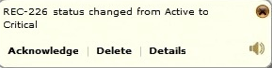
Visual and Audio Alarms
When you select the Visual Alert action on the Alarm Settings dialog, the following dialog will pop up in the bottom right corner of the ESMI whenever an alarm is triggered.
The alert can be acknowledged or deleted by clicking on either of those options.
The visual alert will close after 30 seconds if it hasn't been closed, acknowledged, or deleted.
The audio alert will play until the visual alert is closed, acknowledged, or deleted unless you click on the audio icon, which will stop the audio alert.
If you want to turn off the visual and/or audio alarm notifications temporarily, click on the visual ( )and/or audio ( ) icons in the bottom right corner of the main screen of the ESMI. This will stop all visual and audio notifications until you enable them again or until you close and reopen the ESMI.

Slide 26
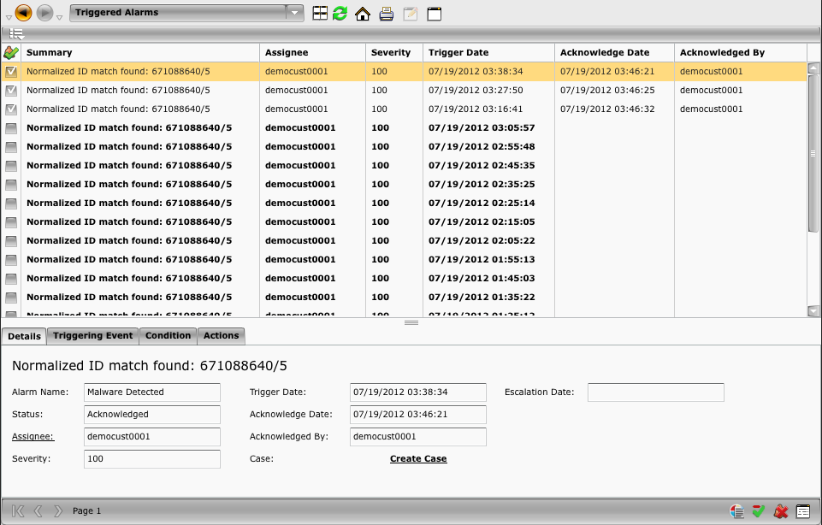
Triggered Alarms View
The Triggered Alarms view shows all the alarms that have been triggered and have not been deleted.
It provides filter capabilities, allowing you to acknowledge and delete triggered alarms, perform WHOIS Lookups, and summarize using the event that caused the alarm.
The details section of the view allows you to change the assignee; create a case; and view the condition that triggered the alarm, the packet that triggered it, and the action that was taken.

Slide 27
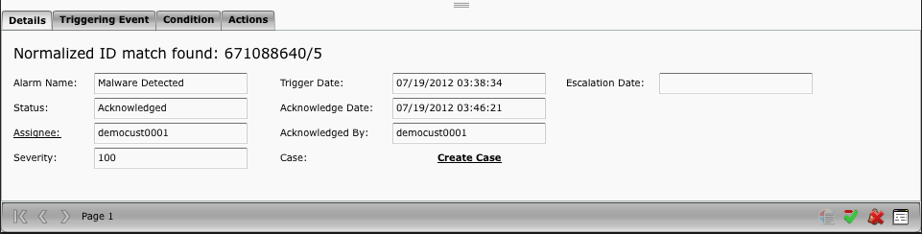
Triggered Alarms – Details Tab
The Details tab allows you to view all of the available information for the current alarm selected/highlighted
Alarm Name
Status
Assignee
Severity
Trigger Date
Acknowledge Date
Acknowledged By
Case
Escalation Date

Slide 28
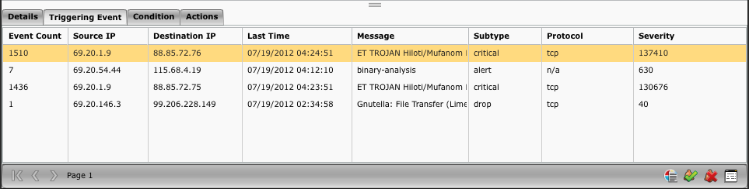
Triggered Alarms – Triggering Events
The Triggering Event tab allows you to view the triggering event details for the current alarm selected/highlighted
Event Count
Source IP
Destination IP
Last Time
Event Message
Subtype
Protocol
Severity

Slide 29
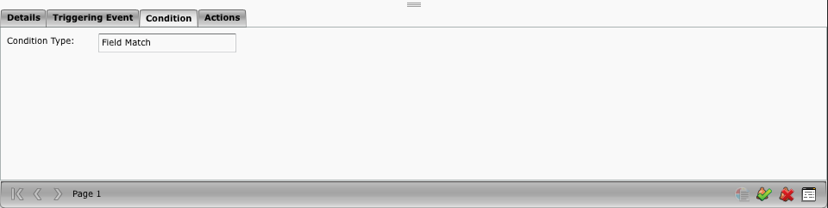
Triggered Alarms – Condition Tab
The Condition tab provides information regarding the alarm trigger condition type that triggered the alarm.

Slide 30
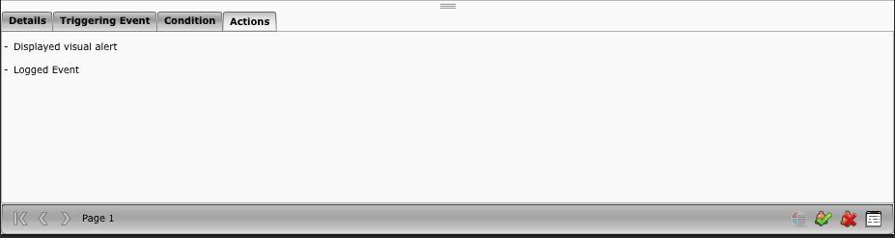
Triggered Alarms – Condition Tab
The Actions tab provides what actions have been taken for the selected/highlighted alarm that was triggered.

Slide 31
When an alarm is triggered, it is automatically added to the Alarms log, located in the pane under the System Navigation Tree pane, as well as the Triggered Alarms View.
True
False
Notes:
Answer: True

Slide 32
Alarms are automatically escalated if they are not acknowledged within 60 minutes?
True
False
Notes:
Answer: False – There is no default escalation time setting configured, but escalation times can be assigned to any alarm.

Slide 33
Hands-on Practice Refer to the Practice Manual Practice 8: Alarms

